Slide 1




SMART INDIA HACKATHON 2026
TITLE PAGE
  Problem Statement ID – SIH26186
  Problem Statement Title- AI-Based Predictive Personnel
Stress and Welfare Monitoring System for Uniformed Forces
  Theme- HealthTech / BioTech / MedTech
  PS Category- Software
  Team ID- 188472
  Team Name - ISM Troopers

Slide 2

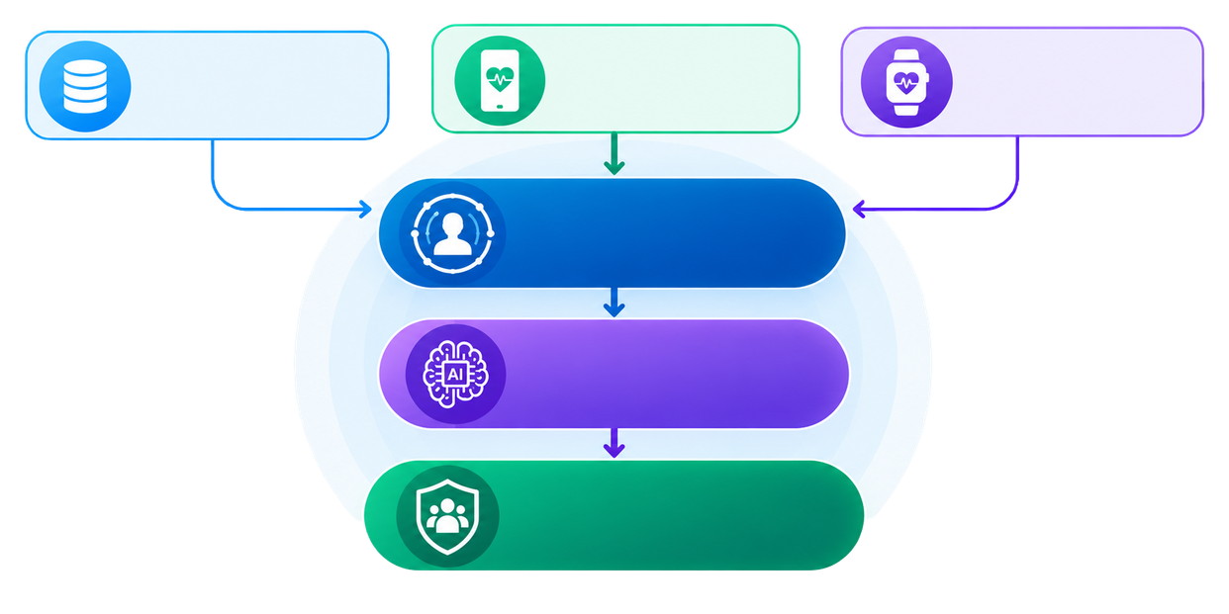

IDEA TITLE
RakshakAI – Predictive Personnel Stress & Welfare Monitoring System
HRMS DATA
WELLNESS APP
OPTIONAL WEARABLES
Leave,Deployment,
Duty,Transfers
Self Assessments,
Feedback
Sleep,Activity,
Health Indicators
Behavioral Risk Analytics
Uses deployment history, leave utilization, duty schedules, transfer frequency, and workload patterns to identify early indicators of stress, fatigue, and burnout.
DIGITAL WELFARE TWIN
Privacy & Security Framework
Implements role-based access control, consent management, data anonymization, encryption, audit logs, and privacy-preserving analytics to ensure trust and confidentiality.
Unfilled & continuous wellness
profile for each personnel
AI RISK ASSESSMENT ENGINE
Detects stress, fatigue &
welfare concerns
WELFARE INTELLIGENCE PLATFORM
Insights Recommendations
Intervention
Personnel Wellness App
Allows personnel to complete wellness self-assessments, track wellness trends, receive AI-generated recommendations, and request support confidentially.
Digital Welfare Twin
Creates a dynamic wellness profile by continuously combining operational data, wellness assessments, and behavioral indicators for each personnel.
AI Risk Prediction Engine
Applies explainable AI and rule-based analytics to detect stress patterns, burnout risks, fatigue trends, and welfare concerns before escalation.
Welfare Intervention Center
Enables welfare officers to review high-risk cases, validate AI findings, coordinate support actions, schedule follow-ups, and monitor intervention outcomes.
Commander Readiness Dashboard
Provides unit-level wellness trends, operational readiness insights, workload distribution analytics, and workforce resilience indicators without exposing sensitive personal data.
@SIH Idea submission- Template
2

Slide 3





















TECHNICAL APPROACH
Frontend:
1.
Mobile & Web UI
(React / React Native)
8.
Dashboard Data to
Commander / Welfare UI
2.
Backend API
(Node.js, Express, FastAPI)
Backend:
7.
Risk Scoring &
Alert Generation
3.
Database
(MongoDB, PostgreSQL).
Tech-Stack
Flow
Database:
Security & Privacy:
6.
Models: XGBoost,
LSTM, NLP (BERT)
4.
HRMS & Wellness
Data Ingestion
5.
ML Model Execution
& Frameworks
ML & Analytics:
@SIH Idea submission- Template
3

Slide 4

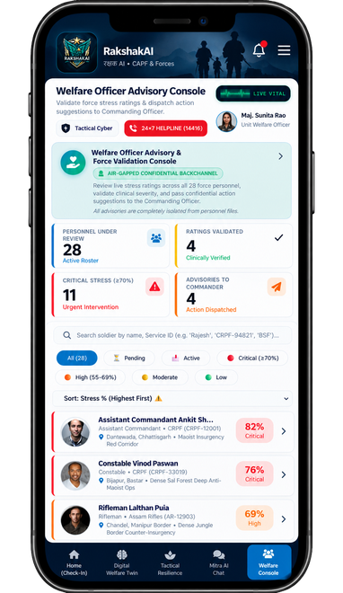
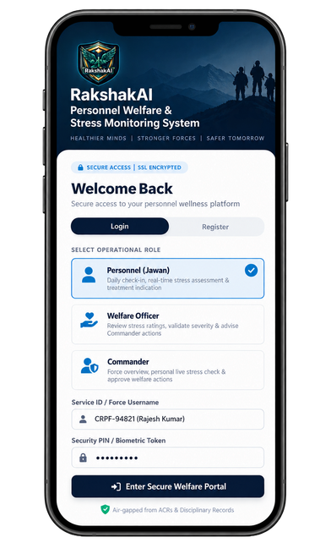
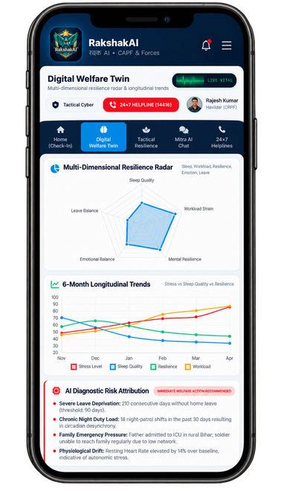
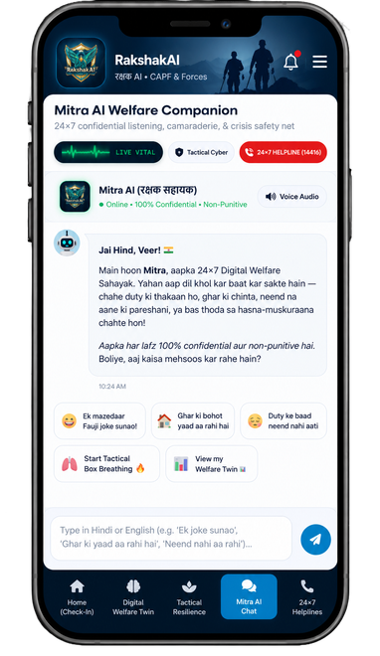




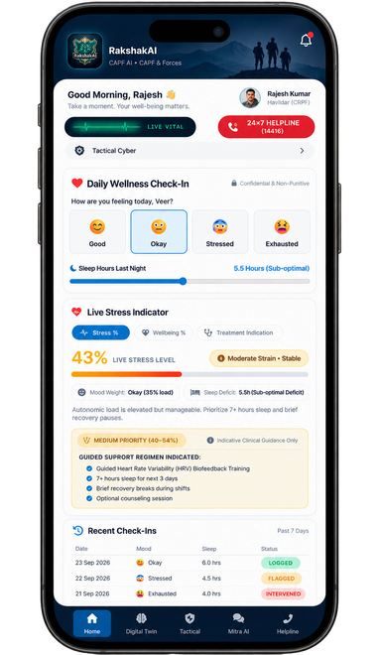
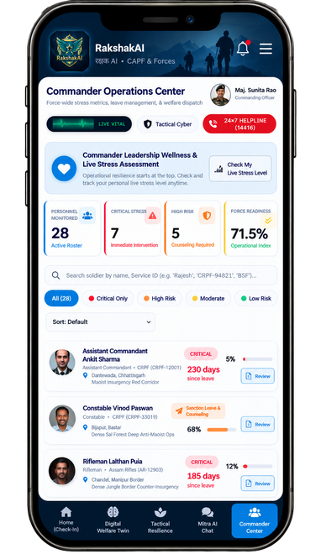
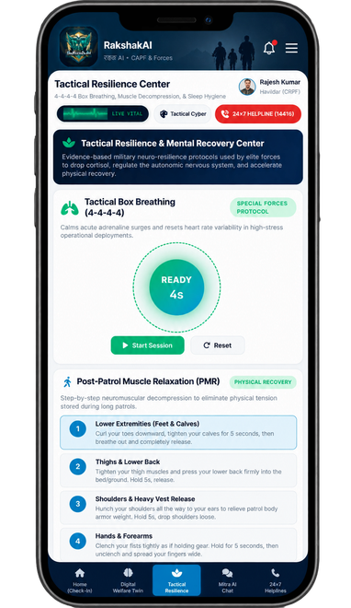
FEASIBILITY AND VIABILITY
Key Challenges & Mitigation Strategies
Challenge 2: Biometric Noise & Environmental Drift• Heavy body armor, extreme climates, and high-altitude hypoxia cause false anomalies in raw physiological sensor data.
Strategy: Multi-Dimensional Diagnostics
Cross-analyze vitals against a 6-month resilience radar, leave deprivation logs, and night shift frequencies to filter out environmental spikes.
Challenge 4: Command Approval Delays in Crisis• Waiting for standard chain-of-command sign-offs blocks urgent mental health interventions during high-stress breakthroughs.
Strategy: 75% Rapid Triage Protocol
Bypass the manual queue automatically when live stress crosses 75%, routing immediate clinical counseling alerts straight to the Medical Officer desk.
Challenge 1: Trust Deficit & Reporting Stigma• Jawans may fake check-in data out of fear that stress ratings will negatively impact their service files or promotions.
Strategy: Cryptographic Privacy Shield
Enforce a strict, explicit "I Consent to Welfare Monitoring" protocol that cryptographically air-gaps all health metrics from ACRs and disciplinary files.
Challenge 3: Disconnected Hierarchy & Communication Gap• Commanders lack direct visibility into real-time force morale, while jawans remain isolated from support due to rigid military command lines.
Strategy: The Welfare Officer Air-Gapped Bridge
Introduce a Welfare Officer role acting as an air-gapped bridge—validating severity and advising commanders while keeping jawans' raw personal data completely private.
Challenge 5: Lack of Immediate Field Decompression• Jawans cannot access psychological counseling in active zones during sudden panic or high-adrenaline combat surges.
Strategy: In-Situ Neuro-Resilience Stations
Embed 4-4-4-4 tactical box breathing counters, post-patrol muscle relaxation flows, and acoustic pink noise directly inside the client interface.
@SIH Idea submission- Template
4

Slide 5






IMPACT AND BENEFITS
Impacts
Early identification of personnel needing welfare support.
Improved mental well-being and workforce resilience.
Enhanced force readiness and operational effectiveness.
Reduction in stress-related incidents and operational fatigue.
Better workload distribution and personnel management.
Benefits
Proactive Welfare Support
Early counseling & intervention before crisis; reduces stress-related attrition.
Data-Driven Planning
Evidence-based resource allocation; informs training & duty scheduling.
Higher Retention & Morale
Improved job satisfaction and stronger trust in leadership.
Privacy-First Design
Dignity and confidentiality protected; builds trust in system adoption.
Operational Readiness
Healthier, resilient workforce with fewer fatigue-related incidents.
Scalable Across Forces
Adaptable to CAPFs, Armed Forces & State Police — an indigenous capability.
@SIH Idea submission- Template
5

Slide 6
RESEARCH AND REFERENCES
CAPF Suicide Burden 2018-2022 (MHA data to Parliament)
654 CAPF personnel died by suicide in this period - 230 in CRPF, 174 in BSF, 89 in CISF - linked to prolonged deployment and workload stress.
Source: theprint.in/india/654-suicides-50000-resignations-in-5-years-the-crisis-stalking-indias-capfs/
HRV-Based Burnout Detection (Operational/Military Contexts)
Machine-learning models on multimodal physiological data enable early detection of autonomic instability and stress risk during training and operations.
Source: research.chalmers.se/publication/550439
Decade-long Toll Since 2011 (MHA data to Parliament, Aug 2023)
1,532 CAPF personnel have died by suicide since 2011, out of a force of about nine lakh personnel.
Source: eurasiantimes.com/a-sobbing-story-of-indian-military-more-soldiers/
HRV-Guided Burnout Early-Warning (Military Training)
MODSIM 2025: RMSSD-based digital-twin simulation flags Stable, Fatigued or Burnout states to guide adaptive training load.
Source: modsimworld.org/papers/2025/MODSIM_2025_paper_64.pdf
CRPF Fratricide-Suicide February 2025, Imphal West, Manipur
A CRPF havildar allegedly opened fire at his camp, killing two fellow soldiers before taking his own life.
Source: etvbharat.com/en/!bharat/former-bsf-ig-emphasises-on-soft-or-peace-posting-for-security-force-personnel-enn25021505147
@SIH Idea submission- Template
6

